Slide 1
Temperature and Humidity Monitoring and Detection
Name ID
Syed Ishtiaque Ahmad 1210367042
Mohammad Ali Zubair 1210374042
Mohammad Rahber-E-Alam Raafa 1210953042

Slide 2
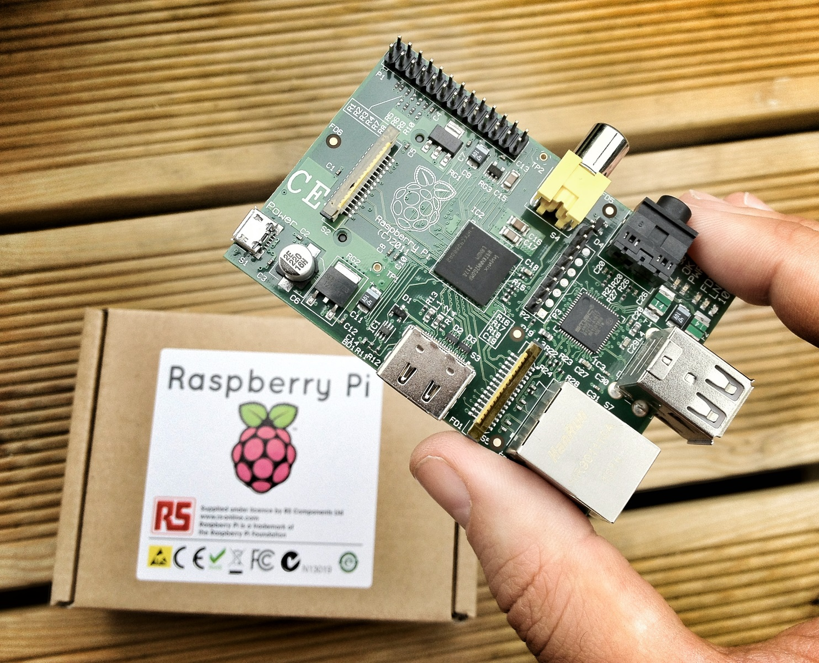
What is a Raspberry Pi?
low cost, credit-card sized computer. (equivalent to a chip used in an old smartphone (Android or iPhone)).
700MHz processor.
2 USB input, 1 Ethernet Cable Input and 1 HDMI output.
512MB RAM.
Supported OS - Arch Linux ARM,[2] Debian GNU/Linux, Gentoo, Fedora, FreeBSD, NetBSD, Plan 9, Raspbian OS, RISC OS, Slackware Linux.
Weight: 45g

Slide 3
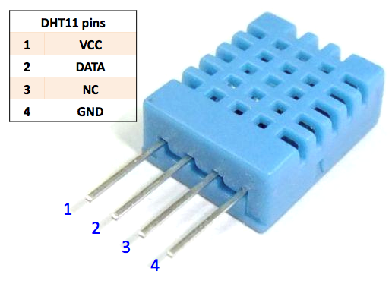
DHT11 Sensor
Low cost.
Requires 3-5V power.
Made of two parts, a capacitive humidity sensor and a thermistor.
Built-in analog to digital converter.
Good for 20-80% humidity readings with ±5% accuracy.
Good for 0-50°C temperature readings ±2°C accuracy.

Slide 4
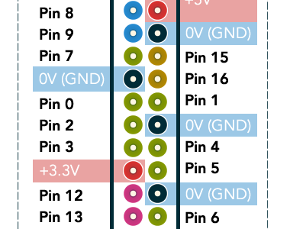
What is WiringPi?
WiringPi is a GPIO access library written in C for the Raspberry Pi.
The DHT11 uses its own serial interface, which can be interrogated using the wiringPi C library.
Header file #include<wiringPi.h> required to incorporate this library within a compiler.

Slide 5
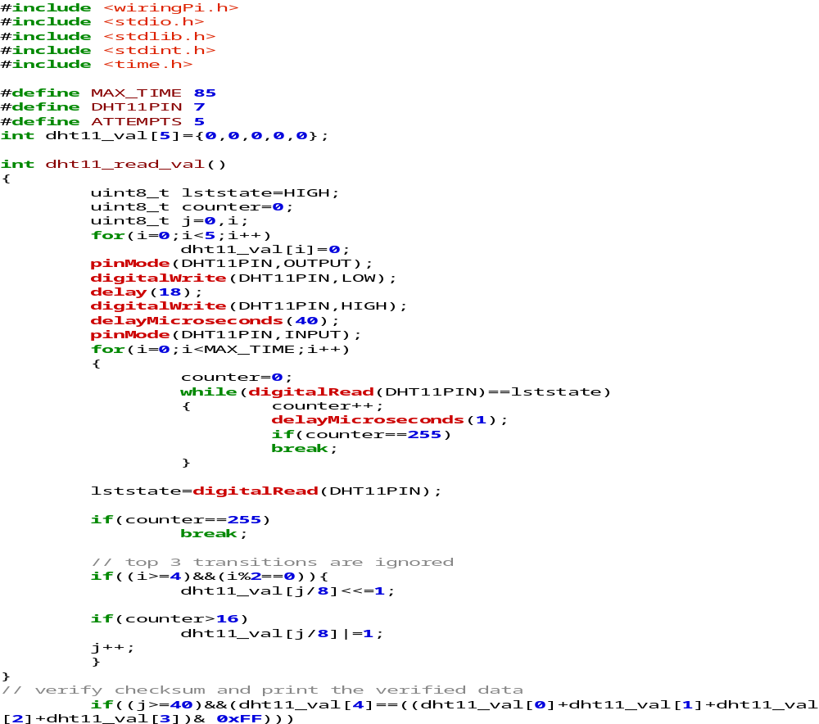
C-Code to Collect the Temperature and Humidity Data:

Slide 6
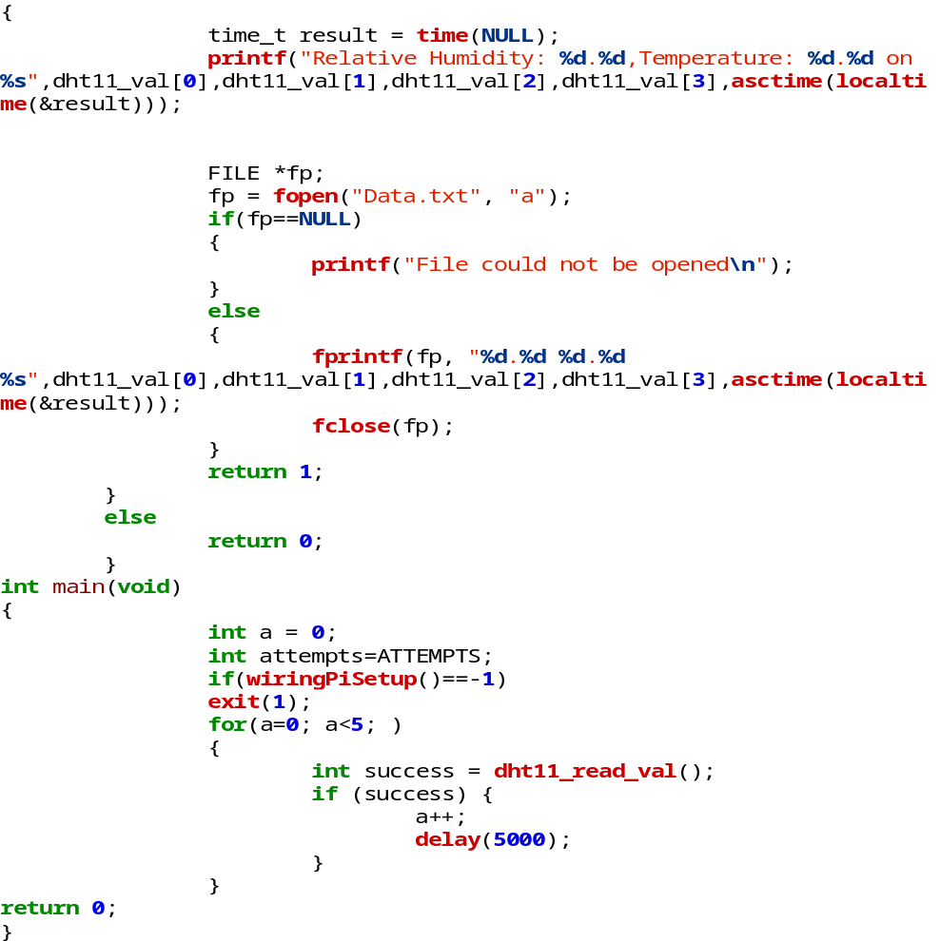
C-Code to Collect the Temperature and Humidity Data:

Slide 7
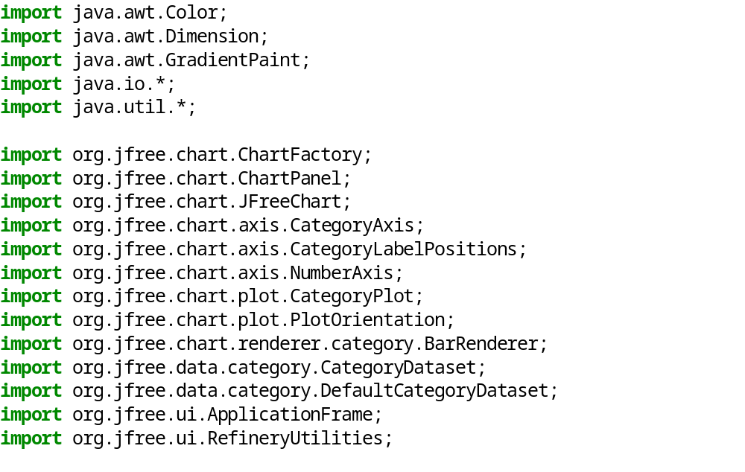
Java-Code to display the results onto a bar chart:

Slide 8
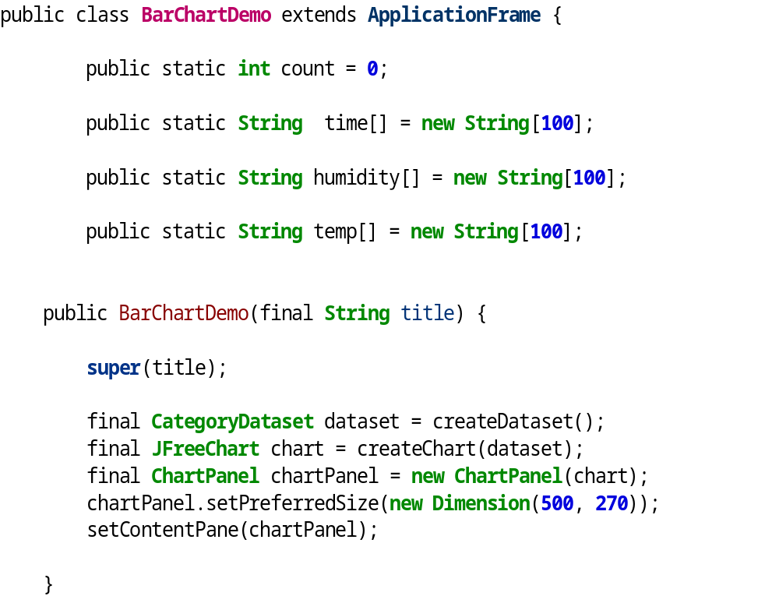
Java-Code to display the results onto a bar chart:

Slide 9
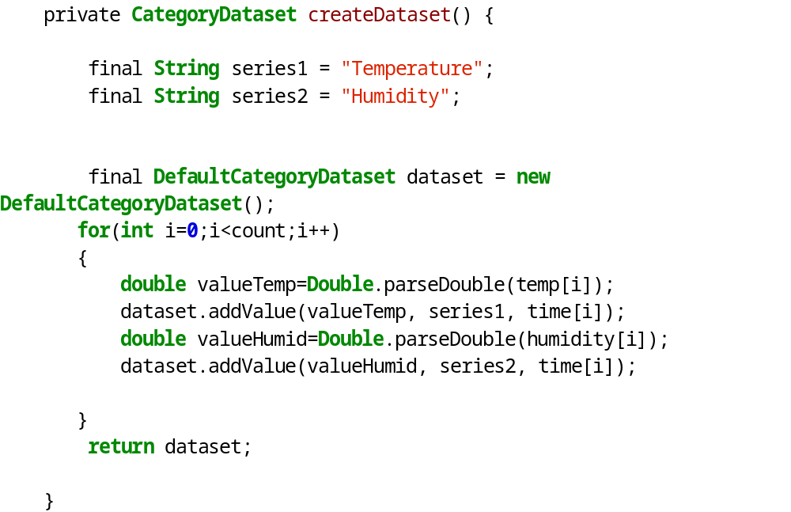
Java-Code to display the results onto a bar chart:

Slide 10
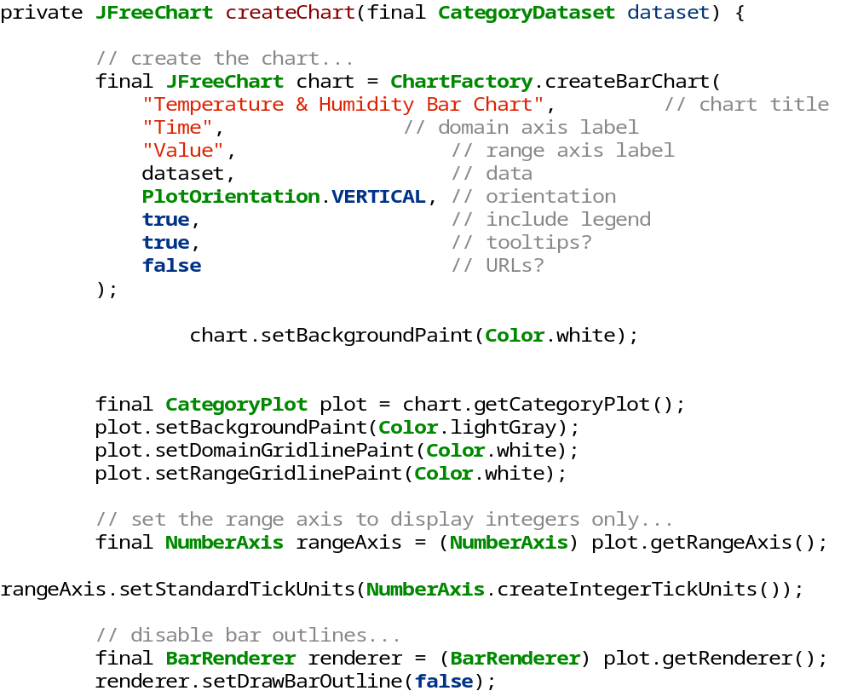
Java-Code to display the results onto a bar chart:

Slide 11
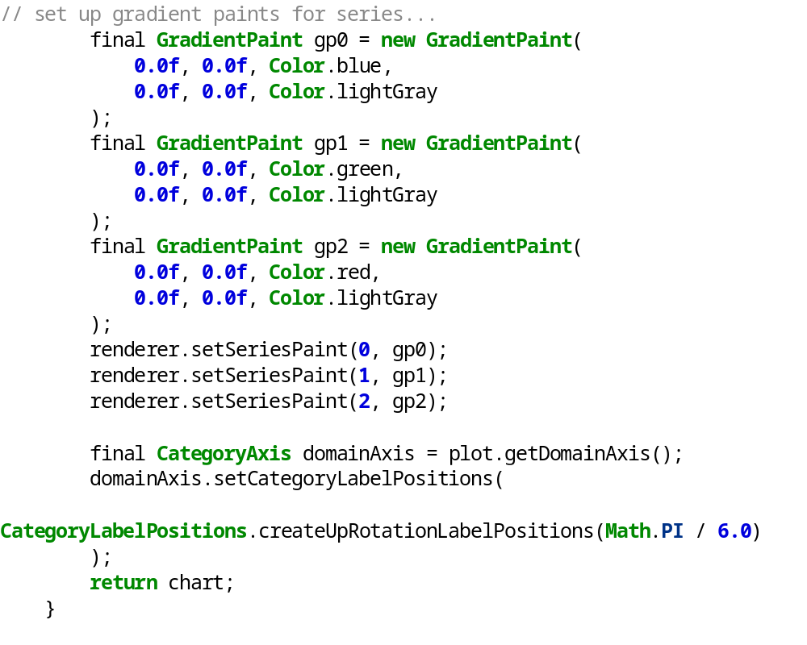
Java-Code to display the results onto a bar chart:

Slide 12
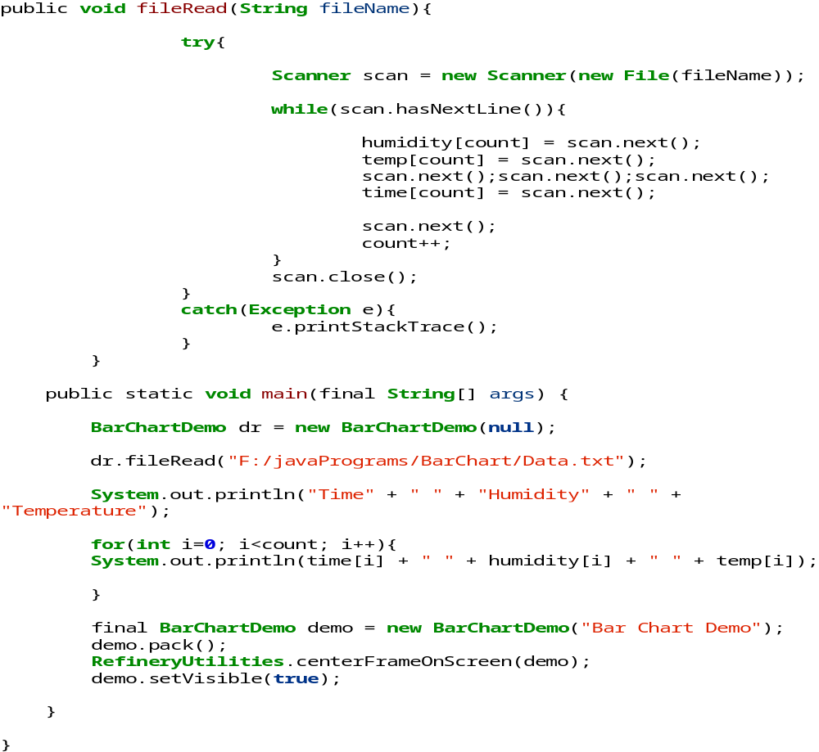
Java-Code to display the results onto a bar chart:

Slide 13
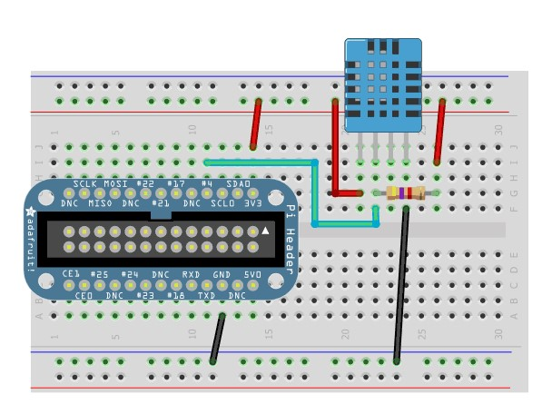
Circuitry
RPi VCC (pin 1) -> DHT11 pin 1
RPi GPIO4 (pin 7) -> DHT11 pin 2
RPi GND (pin 6) -> DHT11 pin 4
The connection is given using 3 wires, the left pin is connected to VCC (pin 1), the data pin is next after VCC and is connected to pin 7. Next pin is NC (no connection). Finally the last pin is connected to GND(pin 25).To prevent random data generation, we connect a 10K resistor between data and VCC pin of DHT11.The 10 kilo ohm resistor initiates a potential difference and ultimately, a current flow across the circuit.

Slide 14
Project Demo

Slide 15
Thankyou

